Slide 1
Access 2016 Module 6
Improving Queries

Slide 2
Module Objectives
Create multitable queries
Apply sorts and view SQL
Develop AND criteria
Develop OR criteria
Create calculated fields
Build summary queries
Build crosstab queries
Create a report on a query

Slide 3
Create Multitable Queries (Slide 1 of 2)
Select query selects fields from related tables and displays records in a datasheet
Query Design View gives you more options for selecting and presenting information
When you open (or run) a query, the fields and records that you selected for the query are presented in Query Datasheet View

Slide 4
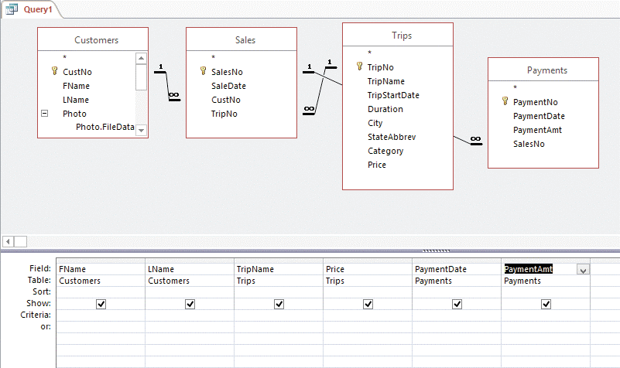
Create Multitable Queries (Slide 2 of 2)
Query Design View with six fields in the query design grid

Slide 5
Apply Sorts and View SQL (Slide 1 of 2)
Sorting refers to reordering records in either ascending or descending order based on the values in a field
You can specify more than one sort field in Query Design View
Sort orders are evaluated from left to right, meaning that the sort field on the far left is the primary sort field
Sort orders defined in Query Design View are saved with the query object

Slide 6
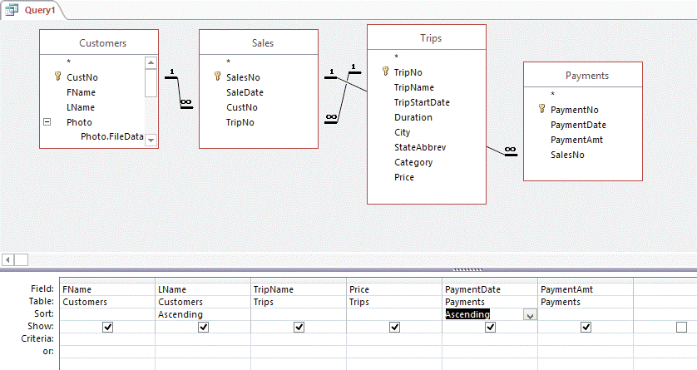
Apply Sorts and View SQL (Slide 2 of 2)
Specifying multiple sort orders in Query Design View

Slide 7
Develop AND Criteria (Slide 1 of 3)
Criteria are tests, or limiting conditions, that must be true for the record to be selected for a datasheet
To create AND criteria, which means the query selects a record only if all criteria are true
enter two or more criteria on the same Criteria row of the query design grid.
To create AND criteria for the same field
enter the two criteria in the same Criteria cell separated by the AND operator.

Slide 8
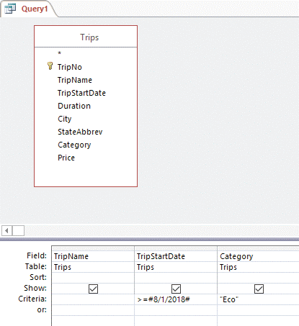
Develop AND Criteria (Slide 2 of 3)
Entering AND criteria on the same row

Slide 9
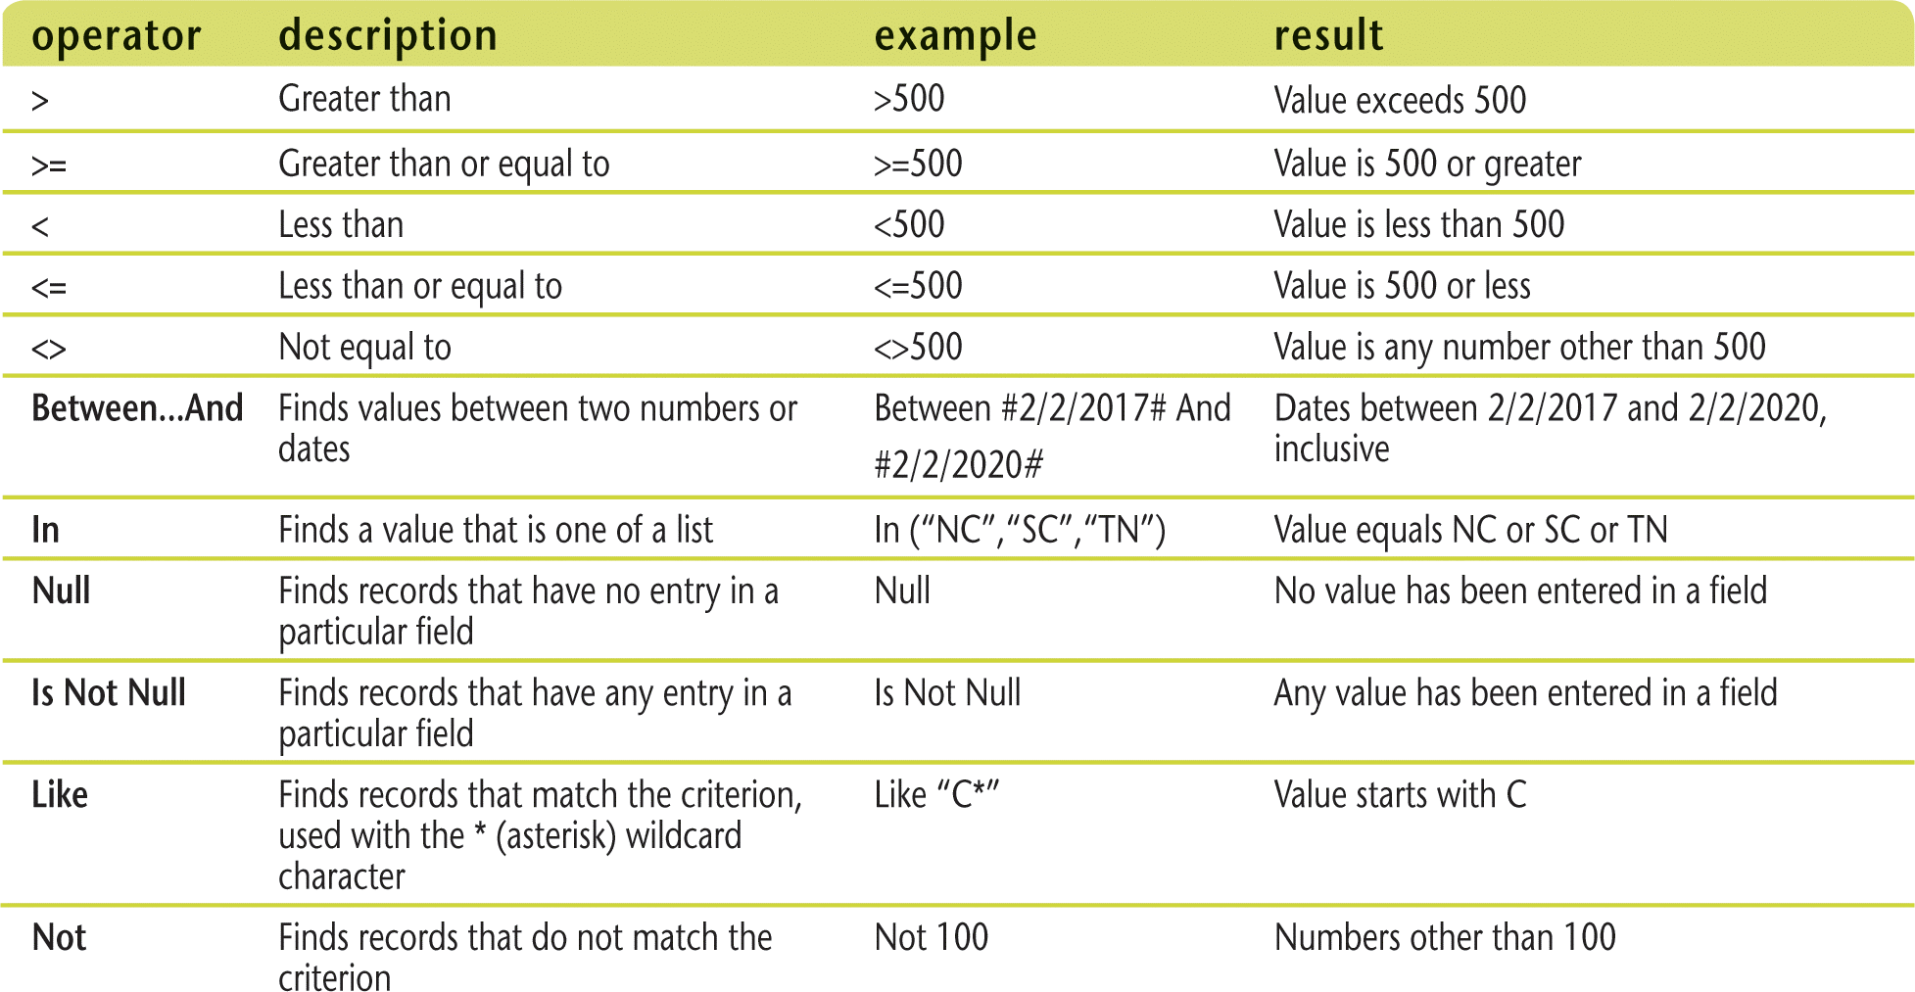
Develop AND Criteria (Slide 3 of 3)
Common comparison operators

Slide 10
Develop OR Criteria (Slide 1 of 2)
OR criteria expand the number of records in the datasheet
A record needs to be true for only one of the criteria
Enter OR criteria in the query design grid on different criteria rows
Wildcard characters
Can search for a pattern
Use a question mark (?) to search for any single character
Use an asterisk (*) to search for any number of characters
Use the Like operator

Slide 11
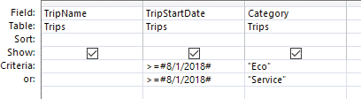
Develop OR Criteria (Slide 2 of 2)
Entering OR criteria on different rows

Slide 12
Create Calculated Fields (Slide 1 of 3)
Calculated field
A field of data that can be created based on the values of other fields.
Expression
A combination of field names, operators (such as +, –, /, and *), and functions that result in a single value.
Function
A predefined formula that returns a value such as a subtotal, count, or the current date.

Slide 13

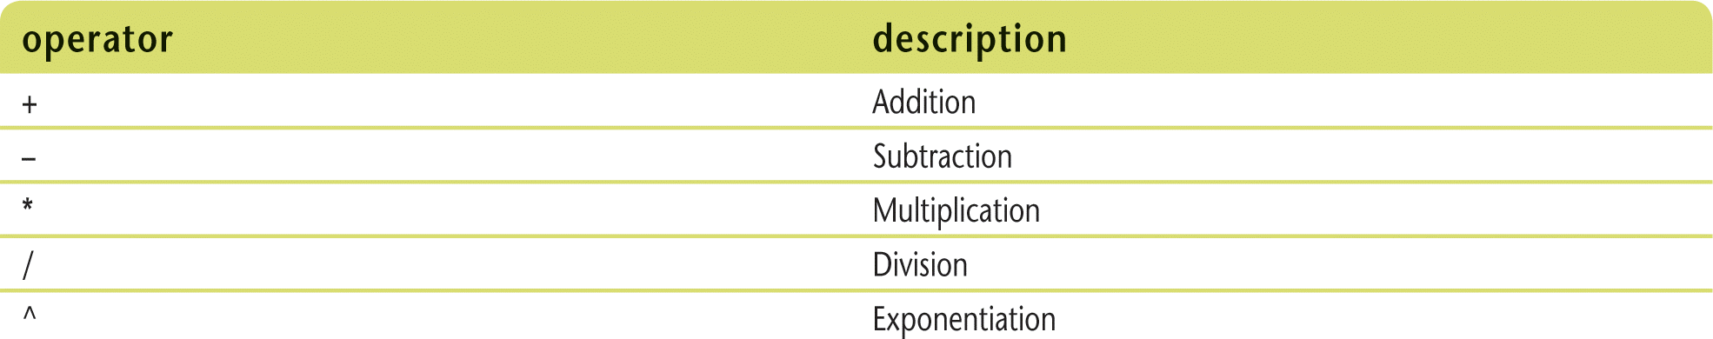
Create Calculated Fields (Slide 2 of 3)
Creating calculated fields
Arithmetic operators

Slide 14
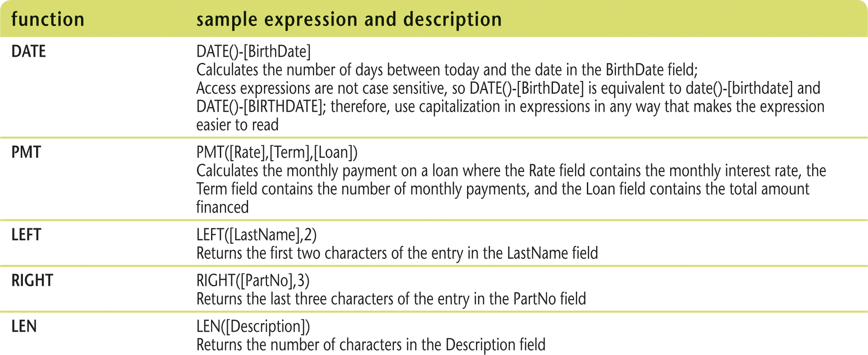
Create Calculated Fields (Slide 3 of 3)
Common functions

Slide 15
Build Summary Queries (Slide 1 of 3)
Summary query
calculates statistics about groups of records
Add the Total row to the query design grid to
specify how you want to group and
calculate the statistics using aggregate functions.
Aggregate functions
calculate a statistic such as a subtotal, count, or average on a field in a group of records

Slide 16
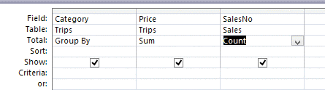
Build Summary Queries (Slide 2 of 3)
Summary query in Design View

Slide 17
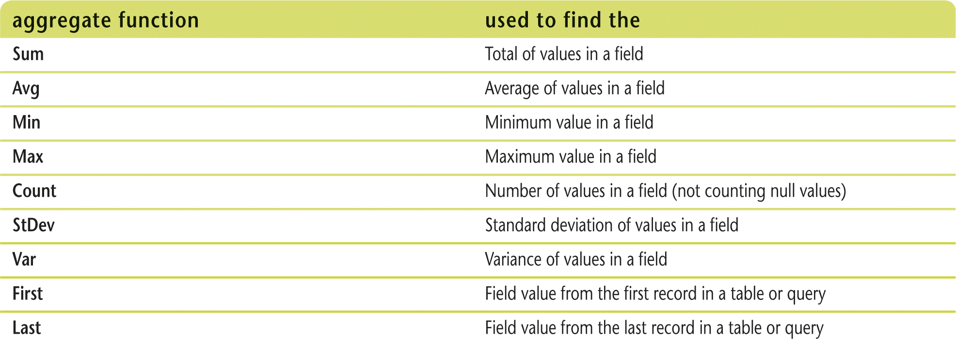
Build Summary Queries (Slide 3 of 3)
Aggregate functions

Slide 18
Build Crosstab Queries (Slide 1 of 2)
Crosstab query
subtotals one field by grouping records using two other fields that are placed in the column heading and row heading positions.
Use the Crosstab Query Wizard to
guide you through the steps of creating a crosstab query, or
can build the crosstab query from scratch using Query Design View

Slide 19
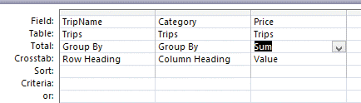
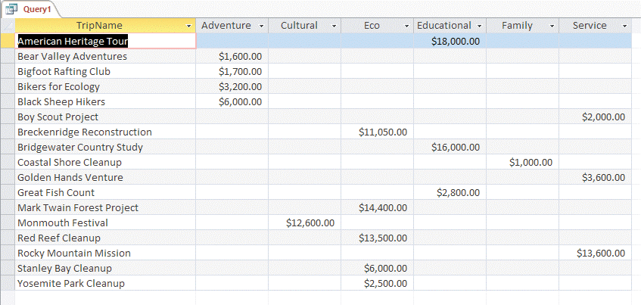
Build Crosstab Queries (Slide 2 of 2)
Query Design View of crosstab query
Crosstab query datasheet

Slide 20
Create a Report on a Query (Slide 1 of 2)
Use a report object
when you want a more professional printout of the information that can be provided by a query datasheet
When you base a report on a query the query name is identified in the Record Source property of the report.

Slide 21
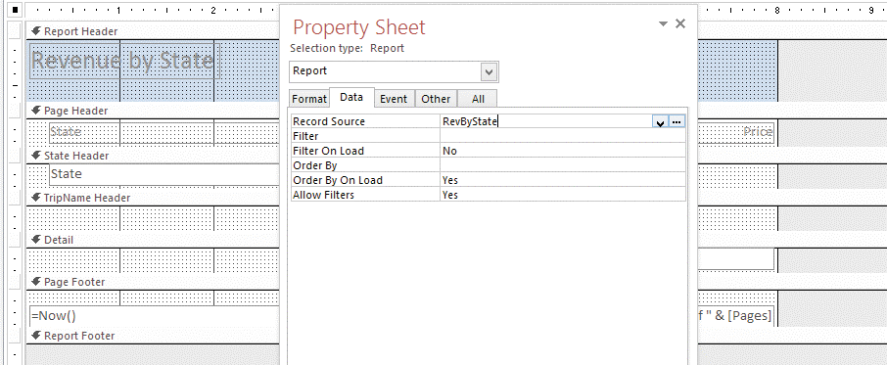
Create a Report on a Query (Slide 2 of 2)
Modifying a query from the Record Source property

